Slide 1

5 Mistakes Journalists Make When Covering Education Research
Holly Yettick
Director, Education Week Research Center
Slides and more information: HollyYettick.com

Slide 2
1. Ignoring research. Ignoring peer- reviewed research.
Ed Research
Source: Yettick, H. (2015). One small droplet: News media coverage of peer-reviewed and university-based education research and academic expertise. Educational Researcher, 44, 173-184.

Slide 3
I guarantee you will find something useful here
Annual Research Conference of the Association for Education Finance and Policy https://aefpweb.org/sites/default/files/AEFP%2041th%20Program.pdf
Annual Conference of the American Educational Association https://convention2.allacademic.com/one/aera/aera16/

Slide 4
2. Ignoring research reviews
Research Reviews Can:
Add context
Save you time
Provide story ideas: Example, teen dating violence
  http://rer.sagepub.com/
  http://www.aera.net/Newsroom/NewsReleasesandStatements/StudySnapshotTeenDatingViolencePreventionProgramsFallShort/tabid/16240/Default.aspx

Slide 5
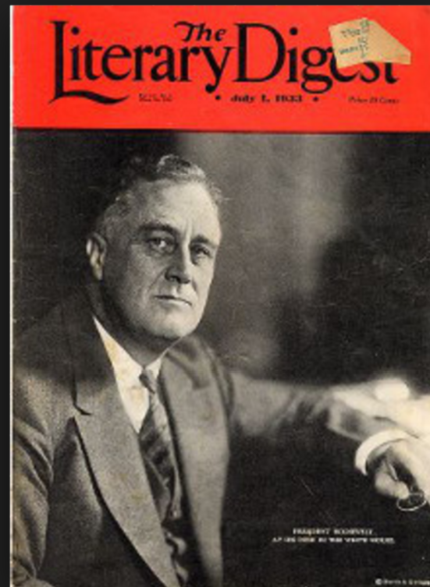
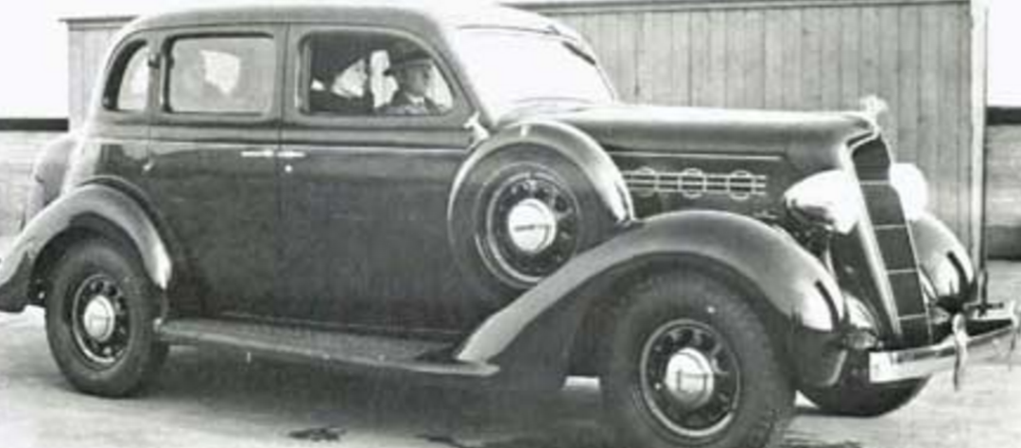
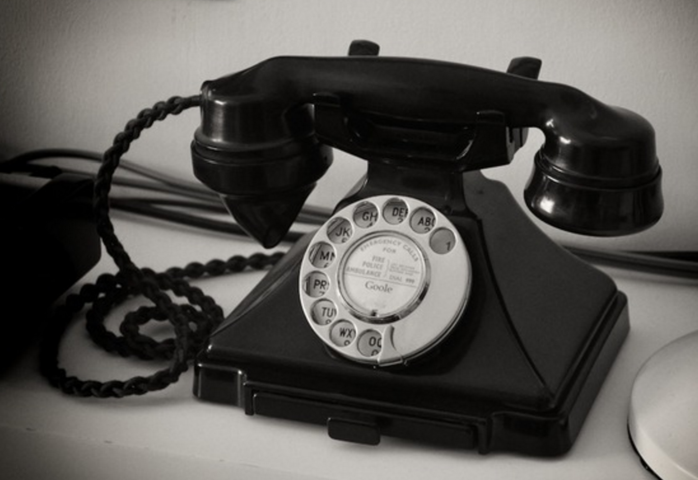
3. Paying more attention to sample size than to how the sample was selected
1936 Literary Digest Poll of 2.4 million Americans: Alfred Landon will Beat Franklin D. Roosevelt

Slide 6
4. Failing to size things up
Questions to Answer in Your Story
Ask the researcher
  How big was the effect or difference?
Ask teachers/instructors, ed leaders:
Is [X] worth implementing given the size of the effect and the associated tradeoffs and costs?

Slide 7
5. Over-generalizing conclusions
Examples
  AGE: Applying findings from higher ed to K-12, and vice versa.
  NATIONS: Applying findings from one country to another
  SOCIO-ECONOMIC STATUS: Applying findings from wealthy communities to low-income communities, and vice versa.

